Slide 1

Computer Programming for Engineers
Week 10 Lecture 1
Nov. 1, 2022
Lecturer: Mohammad Mahdi Javidan
College of Engineering, Sungkyunkwan University
Fall Semester 2022

Slide 2
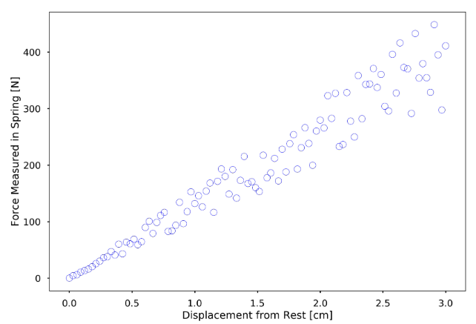
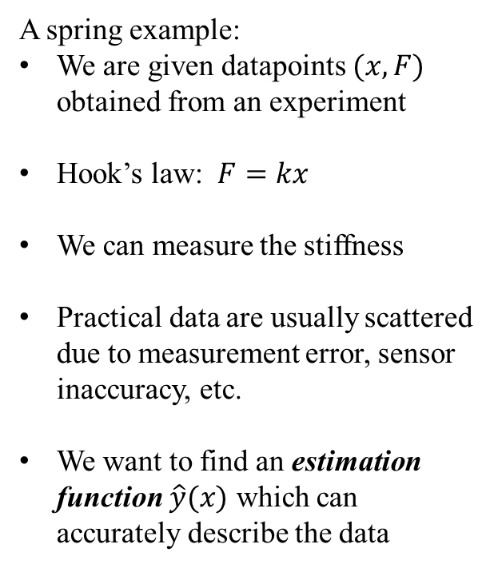
Least Squares Regression
A spring example:
We are given datapoints $(x,F)$ obtained from an experiment
Hook’s law: $F=kx$
We can measure the stiffness
Practical data are usually scattered due to measurement error, sensor inaccuracy, etc.
We want to find an estimation function $\hat{y}(x)$ which can accurately describe the data
College of Engineering, Sungkyunkwan University

Slide 3

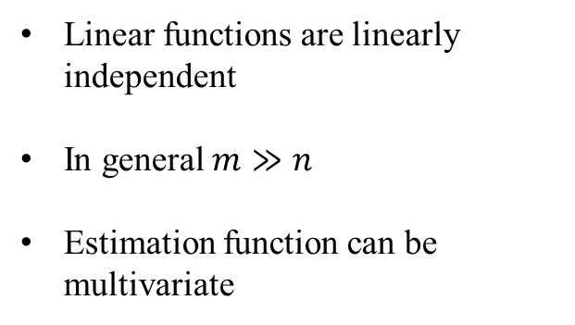



Least Squares Regression
Linear functions are linearly independent
In general $m≫n$
Estimation function can be multivariate
$$\hat{y}\left(x\right)=\sum_{i=1}^{n}{α_{i}f_{i}(x)}$$
Basis functions
Parameters of the estimation function
$$E=\sum_{i=1}^{m}{{(\hat{y}−y_{i})}^{2}}$$
Total squared error
$$E={\left\|e\right\|}^{2}$$
$$e=(\hat{y}−y_{i})$$
residual
College of Engineering, Sungkyunkwan University

Slide 4
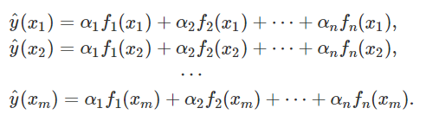
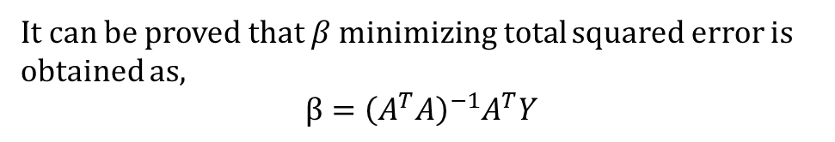
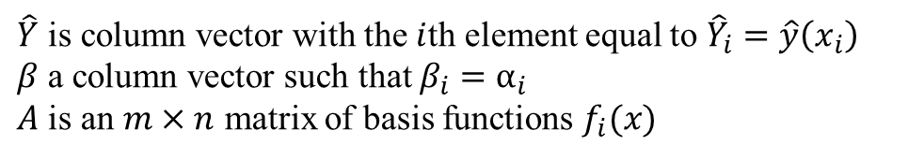
Least Squares Regression
$\hat{Y}$ is column vector with the $i$th element equal to ${\hat{Y}}_{i}=\hat{y}\left(x_{i}\right)$
$β$ a column vector such that $β_{i}=α_{i}$
$A$ is an $m×n$ matrix of basis functions $f_{i}(x)$
It can be proved that $β$ minimizing total squared error is obtained as,
$$β={\left(A^{T}A\right)}^{−1}A^{T}Y$$
College of Engineering, Sungkyunkwan University

Slide 5

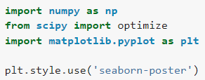

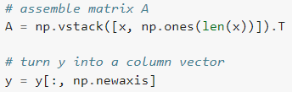



Direct Inverse Method
The function $y=1+1.5x$
np.vstack concatenates matrices
np.newaxis is None
slope
intercept
College of Engineering, Sungkyunkwan University

Slide 6
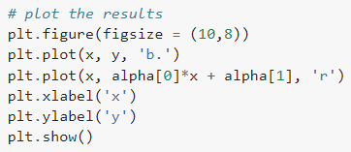
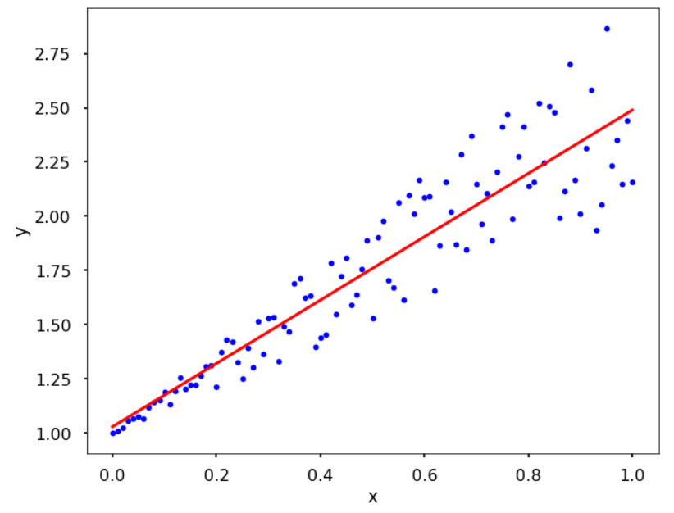
Direct Inverse Method
College of Engineering, Sungkyunkwan University

Slide 7





In-Built Functions
${\left(A^{T}A\right)}^{−1}A^{T}$ is called pseudo-inverse
Least squares method in numpy
First return is parameters
Other returns are residuals, rank of matrix, etc.
College of Engineering, Sungkyunkwan University

Slide 8

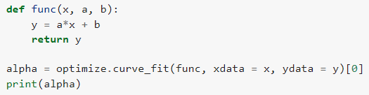

Optimization
Optimization function in scipy
No need to turn y into a column vector
College of Engineering, Sungkyunkwan University

Slide 9






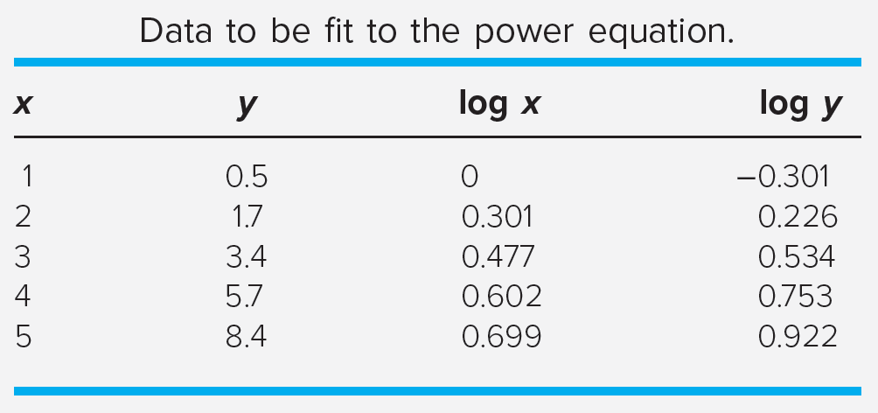
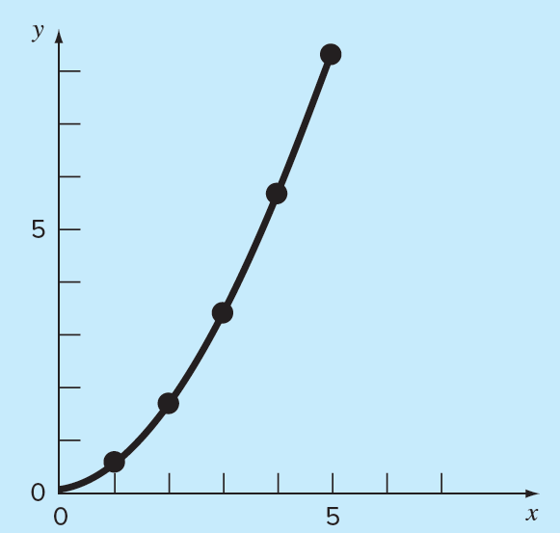
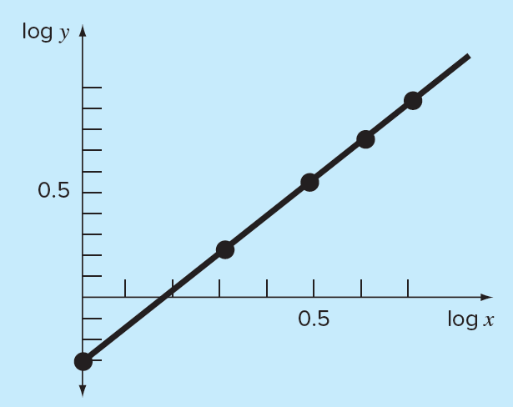


Nonlinear Functions
Exponential model
Power equation
Saturation-growth-rate equation
College of Engineering, Sungkyunkwan University

Slide 10
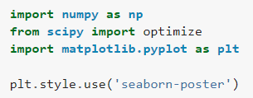



Nonlinear Functions
The exponential function $y=0.1e^{0.3x}$
College of Engineering, Sungkyunkwan University

Slide 11
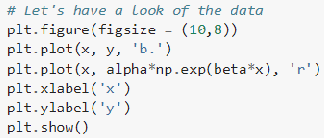
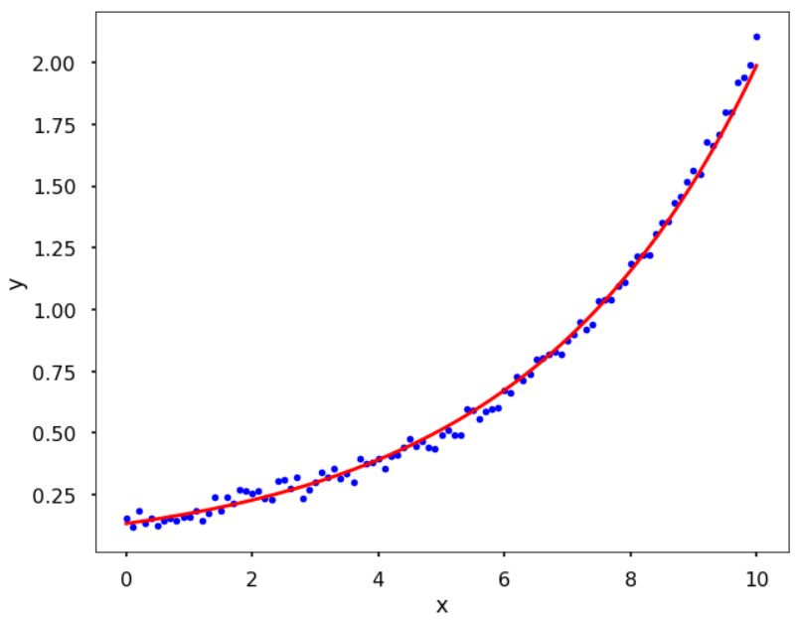
Nonlinear Functions
College of Engineering, Sungkyunkwan University

Slide 12
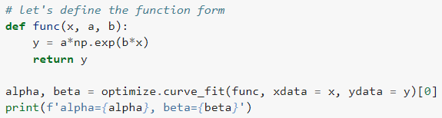
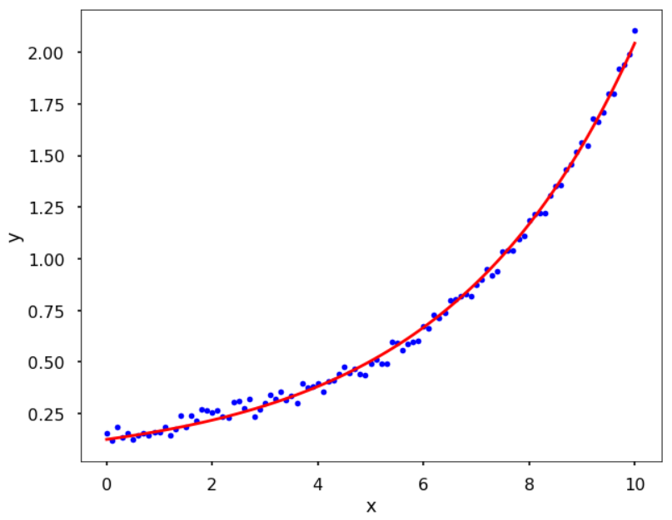
Nonlinear Functions
Using scipy library
College of Engineering, Sungkyunkwan University

Slide 13
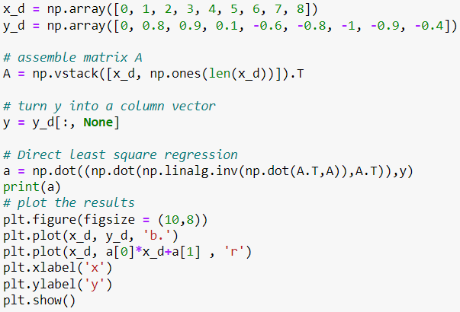

Polynomial Functions
First order function
$$f\left(x\right)=a_{1}x+a_{0}$$
College of Engineering, Sungkyunkwan University

Slide 14
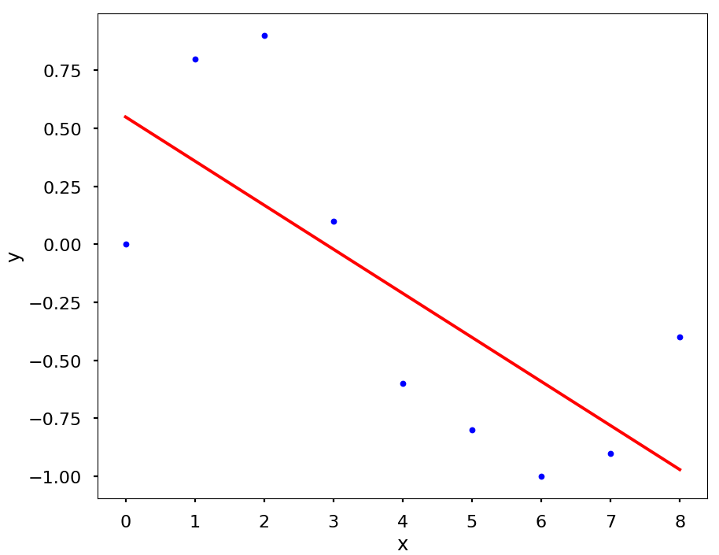
Polynomial Functions
First order function
$$f\left(x\right)=a_{1}x+a_{0}$$
College of Engineering, Sungkyunkwan University

Slide 15
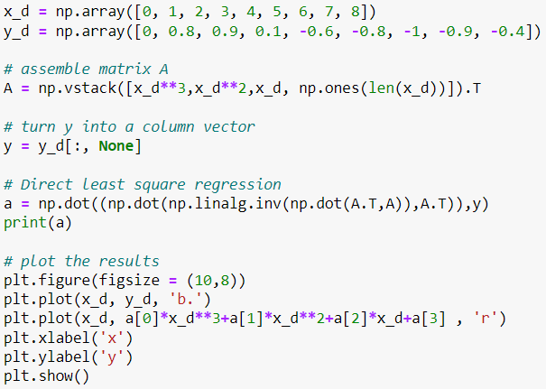


Polynomial Functions
Third order function
$$f\left(x\right)=a_{3}x^{3}+a_{2}x^{2}+a_{1}x+a_{0}$$
College of Engineering, Sungkyunkwan University

Slide 16
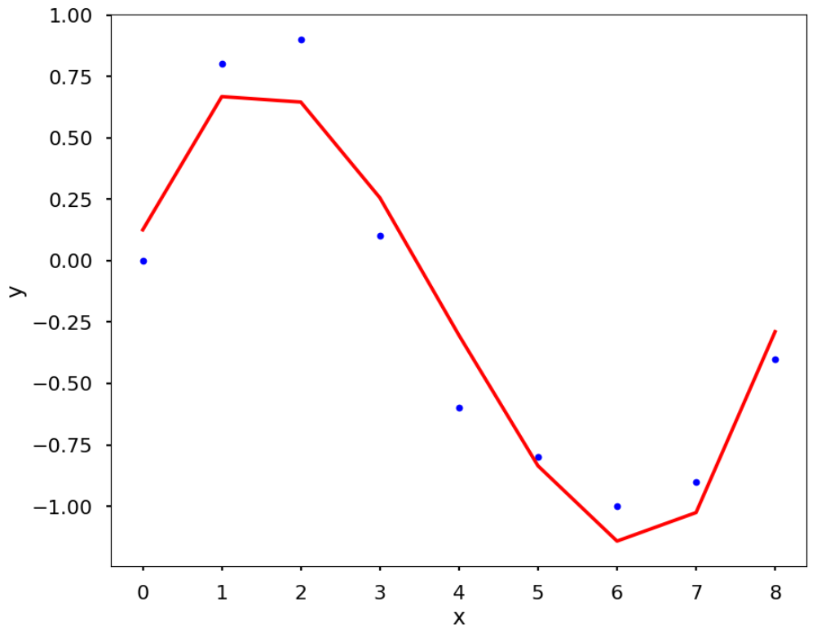
Polynomial Functions
Third order function
$$f\left(x\right)=a_{3}x^{3}+a_{2}x^{2}+a_{1}x+a_{0}$$
College of Engineering, Sungkyunkwan University

Slide 17
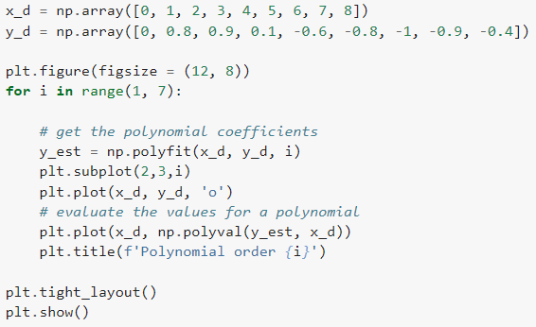
Polynomial Functions
Obtain the coefficients of different order polynomials with the least squares using the function numpy.polyfit
use numpy.polyval to get specific values of a polynomial for the given coefficients
College of Engineering, Sungkyunkwan University

Slide 18
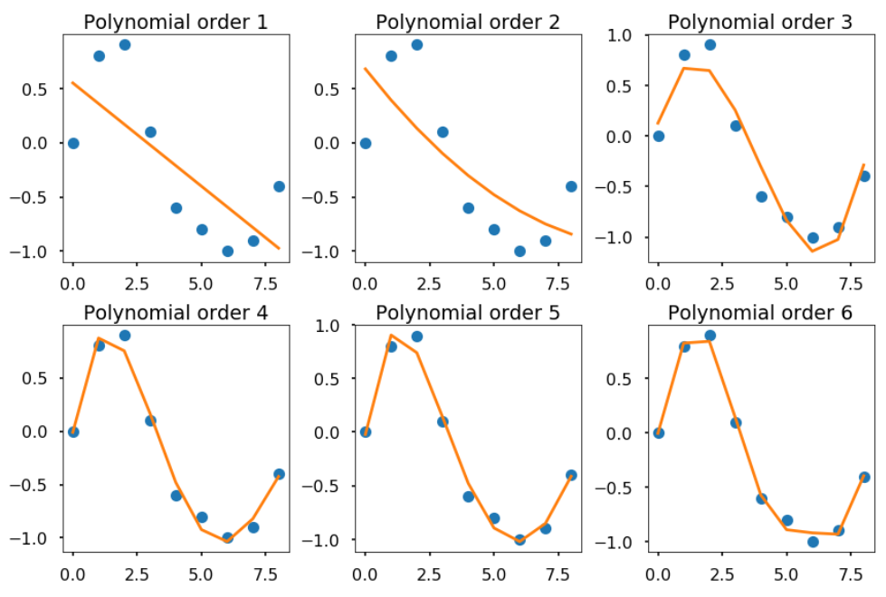
Polynomial Functions
College of Engineering, Sungkyunkwan University

